Slide 1
Game History and Genres
Introduction to Game Design and Development
ITCS 4230/5230
Dr. Dewan Tanvir Ahmed
Department of Computer Science
University of North Carolina at Charlotte

Slide 2
Objectives
History of Games
Milestone Games
Attributes of good games
Game Genres

Slide 3


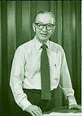
Origins
1951: Ralph Baer suggested adding game to TV
Considered the inventor of video games
1952 A.S. Douglas (@Cambridge):
Interactive Tic Tac Toe
1958 Willy Higinbotham (@brookhaven national laboratory):
A table tennis-like game was played on an oscilloscope.

Slide 4
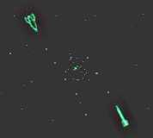
Origins (cont.)
1962 Steve Russell and a group of MIT students (MIT) programmed a game called “Spacewar”
“If I hadn't done it, someone would've done something equally exciting if not better in the next six months. I just happened to get there first.
- Steve Russell
First interactive computer game.
The graphics are made up of ASCII text characters.
The computer manufacturer (DEC) decided to distribute this game with its mainframe computers.

Slide 5
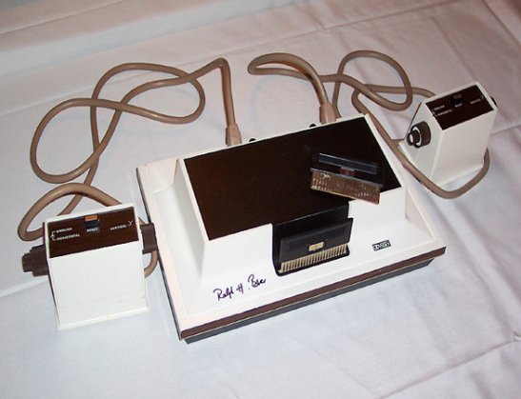
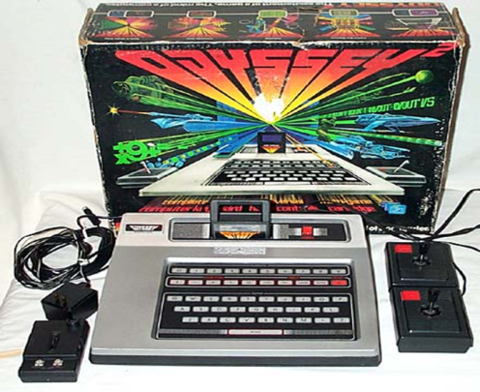
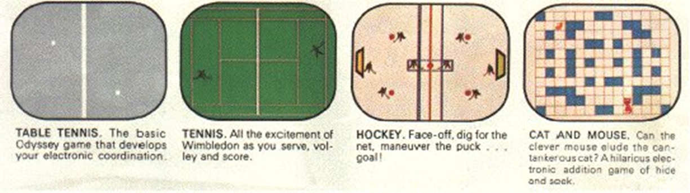
Home video games
1968: Ralph’s project was completed and he dubbed it the “Brown Box”.
Later sold to Magnavox – includes tennis, hockey, and some shooting games
Released 1972

Slide 6
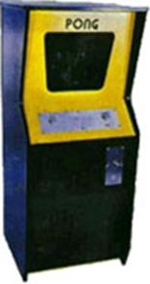
Atari Era
1972: Nolan Bushnell created an arcade tennis game named Pong.
Atari bought the program and began distribution in 1973 (both arcade and home formats).
Computer Space becomes first video arcade game ever released.
1500 games are distributed.
Public consensus - too difficult to play.

Slide 7
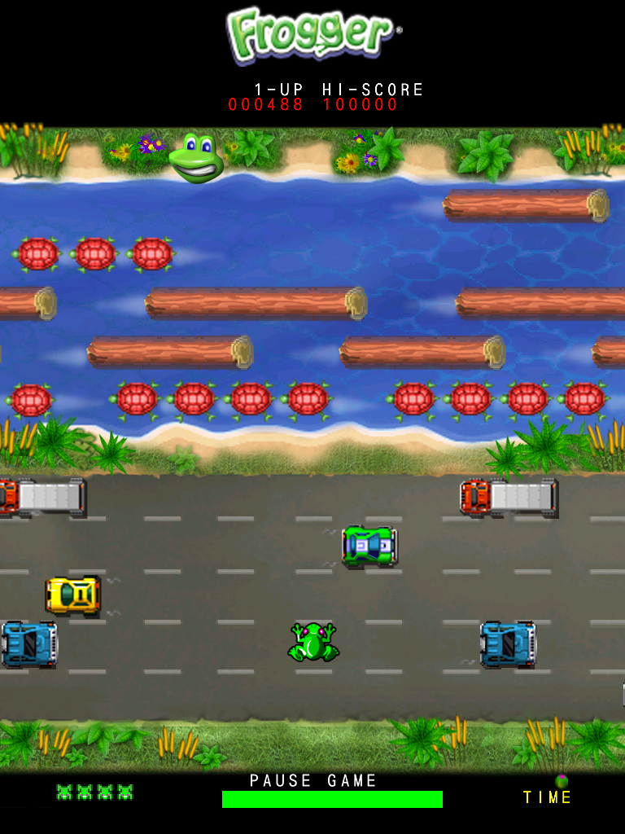
The Golden Age 1979-1981
Atari releases Asteroids!
Frogger, Konami/Sega, 1981
Pac-Man, Bally/Midway, 1980
Donkey Kong, Nintendo, 1981
Nintendo releases first console in 1981
http://www.tripletsandus.com/80s/80s_games/

Slide 8
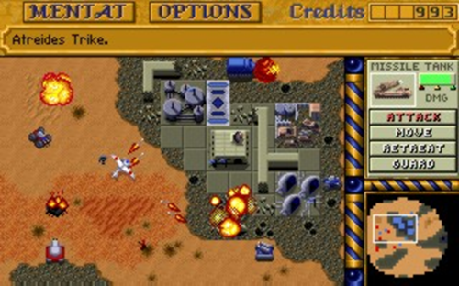
Rise of Computer Games
Computer games were increasingly popular (two new genres)
Strategy games and
First Person Shooters (FPS).

Slide 9
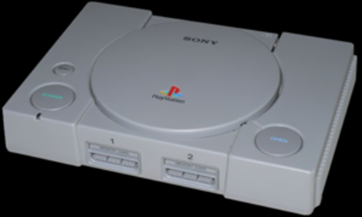
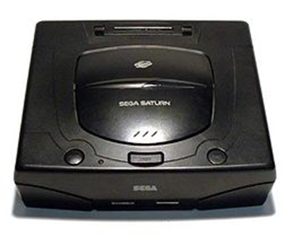
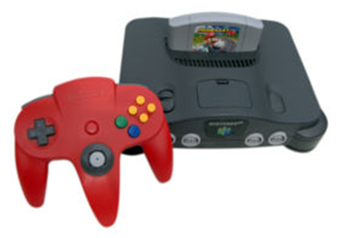
Modern Age
1994: Sony PlayStation
1995: Sega Saturn
1996: Nintendo 64

Slide 10
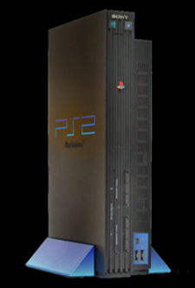
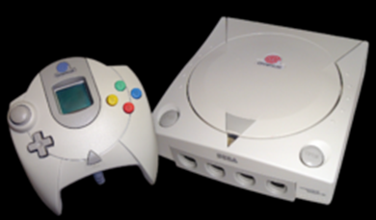
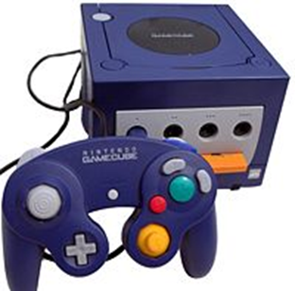
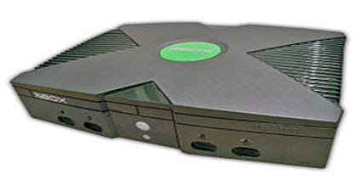
6th Generation
PlayStation 2 - Sony
Sega Dreamcast
Nintendo GameCube
Microsoft Xbox

Slide 11
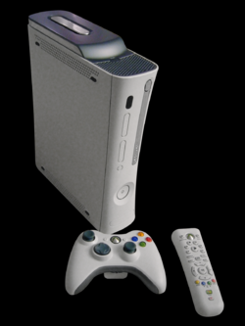
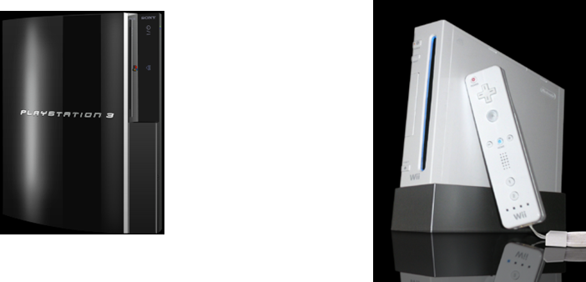
7th Generation
2005: Microsoft Xbox 360
2006: Sony PlayStation 3
2006: Nintendo Wii
Timeline: Video Games

Slide 12
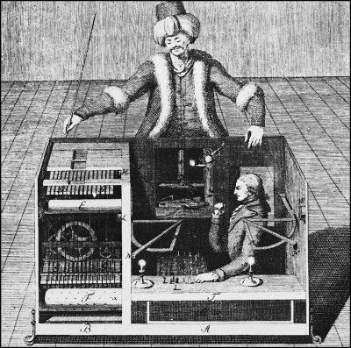

Chess Origins
1769 Fake chess machine
1952 Turing design a chess algorithm
1956 Maniac I (11,000 operations a second) versus Human
Notes:
It took 12 minutes to search 4 moves deep. Adding the two bishops would have taken 3 hours to search 4 moves deep

Slide 13
Objectives
A History of Games
Milestone Games
Criteria of good games
Game Genres

Slide 14
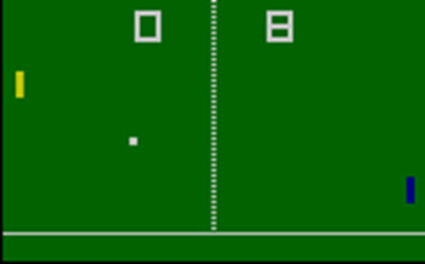
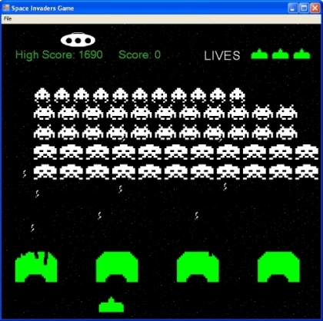
Milestone Games
Pong (1972, Atari Inc.) and space invaders (1978): 1st videogame hits
The aim is to defeat the opponent in a simulated table tennis game by earning a higher score.
An earliest shooting games and the aim is to defeat waves of aliens with a laser cannon to earn as many points as possible
Notes:
Pong (marketed as PONG) is one of the earliest arcade video games;
it is a tennis sports game featuring simple two-dimensional graphics.
The aim is to defeat the opponent in a simulated table tennis game by earning a higher score.

Slide 15
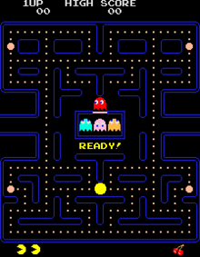
Milestone Games (cont.)
Pac-man (Japan on May 22, 1980)
Arcade game developed by Namco
Appealing to both genders
One of the highest-grossing video games of all time
Generated more than $2.5 billion in quarters by the 1990s
Notes:
The player controls Pac-Man through a maze, eating pac-dots (also called pellets). When all pac-dots are eaten, Pac-Man is taken to the next stage. Between some stages one of three intermission animations plays. Four enemies (Blinky, Pinky, Inky and Clyde) roam the maze, trying to catch Pac-Man. If an enemy touches Pac-Man, a life is lost. When all lives have been lost, the game ends. Pac-Man is awarded a single bonus life at 10,000 points by default

Slide 16
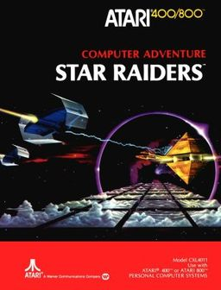
Milestone Games (cont.)
Star raiders: 1st 3D space combat

Slide 17
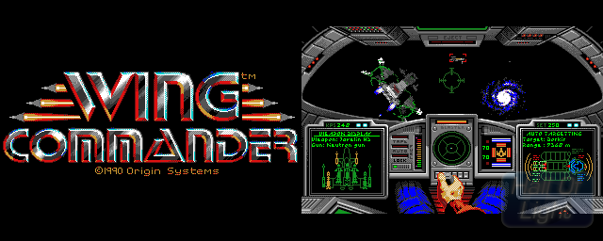
Milestone Games (cont.)
Wing Commander: cutscenes
Space combat simulation video games
The games were all notable for their storytelling through extensive cutscenes
Notes:
A cutscene or event scene (sometimes in-game cinematic or in-game movie) is a sequence in a video game over which the player has no or only limited control, breaking up the gameplay and used to advance the plot, strengthen the main character's development, introduce characters, and provide background information, atmosphere, dialogue, and clue

Slide 18
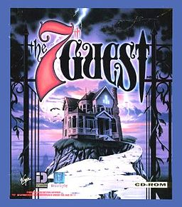
Milestone Games (cont.)
7th Guest: video cut scenes (cinematics)
The game is played by wandering through a mansion, solving logic puzzles and watching videos that further the story.
The main antagonist, Henry Stauf, is an ever-present menace, taunting the player with clues, mocking the player as they fail his puzzles ("We'll all be dead by the time you solve this!"), and expressing displeasure when the player succeeds ("Don't think you'll be so lucky next time!").
Over two million copies sold, and is widely regarded as a killer app
One curscene
Bill Gates called The 7th Guest "the new standard in interactive entertainment”.

Slide 19


Milestone Games (cont.)
FF, MGS: video cut scenes (cinematics)
Half-life: integrated cut scenes
Top 50 cutscenes
Notes:
Final fantasy, metal gear solid

Slide 20

Milestone Games (cont.)
SimCity/Sims
Open-ended city-building computer and console video game
The best-selling computer game up until approximately 2012

Slide 21
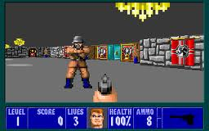

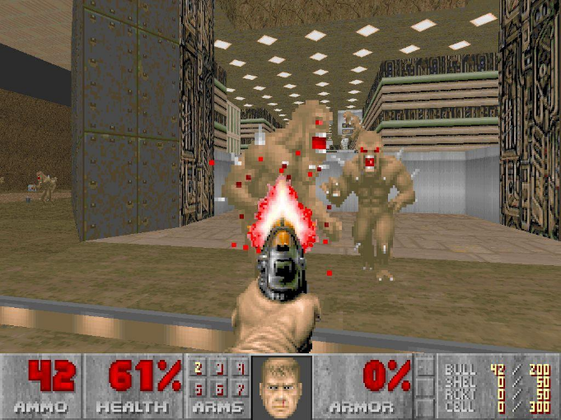
Milestone Games (cont.)
Wolfenstein3D/Doom/Quake: 3D engine, FPS
Notes:
First-person shooter (FPS) is a video game genre centered on gun and projectile weapon-based combat through a first-person perspective; that is, the player experiences the action through the eyes of the protagonist

Slide 22
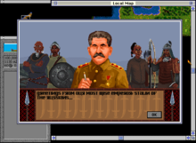
Milestone Games (cont.)
Civilization
Turn-based strategy
Centered around building a civilization on a macro-scale from prehistory up to the near future. Each turn allows the player to move his or her units on the map, build or improve new cities and units, and initiate negotiations with the computer-controlled players
As of 12 March 2008 - sold more than 8 million copies

Slide 23

Milestone Games (cont.)
Tomb Raider (1996)
Notable for its female protagonist
In 2006, Lara Croft was inducted into the Walk of Game and the Guinness Book of World Records has recognised her as the "Most Successful Human Virtual Game Heroine."
Notes:
The Walk of Game was a year-round attraction in the United States honoring the icons and pioneers of the video game industry, and was located inside Metreon, an entertainment shopping center in San Francisco, California. It noted the most influential game characters of that year.

Slide 24
Objectives
A History of Games
Milestone Games
Criteria of good games
Game Genres

Slide 25
Pick your games
Name THREE BAD games
Name THREE GOOD games

Slide 26
Student Picks
Good
Blades of Steel, Civilization, Deus Ex, Diablo2, Fable, Far Cry, Grim Fandango, Halo, K.O.T.O.R, Master of Orion, MGS, MYST, Penguins, Prey, Super Mario (64 and Kart), Tetris, Tomb Raider, Unreal Tournament 2004
Bad
DaVinci Code, SimTower, CSI, Heart, L.O.T.R, Quake, Space Invaders, MGS, …

Slide 27
Student Picks
Good
Final Fantasy 7, Tekken 5, Myst, Lord of the Rings Online (Shadows of Ingmar), Quake 3, Thief (series), Half-life 2 (Episode 1), Tetris, Half-life (Counter Strike), Warcraft 3, Sudoku, Street Fighter Alpha 3, Tony Hawk’s Pro Skater, F.E.A.R, Mega Man 2 (NES), Sims, World of Warcraft, Halo, Dance Dance Revolution (Arcade Version), Mario Kart 64, Super Mario Strikers, Starcraft, Need for Speed (Underground)
Bad
Blade & Sword, Call of Duty 3, Ducks Ahoy, Metroid (Wii), Duke Nukem 2, Halo, Doom 3, Doom, Police Quest (SWAT), Mortal Kombat, Ikari Warriors, Leisure Suit Larry (Magna Cum Laude), Cooking Mama Cook Off, Battlecruiser Millennium, Maximo (Ghosts to Glory, PS2), Gauntlet (Dark Legacy), Kingdom Hearts, Jewels of the Oracle, Helicopter Game, WWE SmackDown vs. RAW 2007, Bioshock, Dogs of War, Tekken 4

Slide 28
Attributes
Story
plot, complexity, emotional attachment
Graphics
engine cut scenes
Gameplay
puzzles vs. enemies
challenges, plan, moves
novelty of levels
limited or too much difficulty
player's impact on the world
small yet fun goals
confusion, and choices

Slide 29
Attributes (cont.)
Characters
personality, variety
Interface
ease of understanding and use, controls, physical interactivity
Dialogs
variety
Non-player characters
helpfulness of allies, communication, relationship
Penalties
restarting

Slide 30
Attributes (cont.)
Personal experience
imagination, fantasizing
real role-playing
suspension of disbelief
interactivity, exploration, immersion
Innovation
styles, techniques, moves, objectives
Audio
sound effects, music
Online issues
ease of connection, communication, group work

Slide 31
Attributes (cont.)
Time
loading, delays
Art
being more than just entertaining
Realism
environment, people, objects
Violence
why and how much
Learning
intuitive, documentation, help

Slide 32
Attributes (cont.)
Customization
environment, characters
Offensive content
sexism, stereotypes
Educational effects
negative or positive
Pace
fast vs. slow
Movie clips
frequency, duration, ability to skip

Slide 33
Attributes (cont.)
A History of Games
Milestone Games
Criteria of good games
Game Genres

Slide 34
Choosing a Genre
A genre is a category of games characterized by a particular set of challenges, regardless of setting or game-world content
Many players buy a particular genre because they like the type of challenges it offers

Slide 35
Classic Game Genres
Action games—physical challenges
Strategy games—strategic, tactical, and logistical challenges
Role-playing games— tactical, logistical, exploration, and economic challenges
Real-world simulations (sports games and vehicle simulations) —physical and tactical challenges

Slide 36
Classic Game Genres
Adventure games— exploration and puzzle-solving challenges
Usually action-adventure
Puzzle games— logic and conceptual challenges
Sports and fighting games are basically action games.

Slide 37
Newer Game Genres
Online games—multiplayer distributed games in which the players’ machines are connected by a network

Slide 38
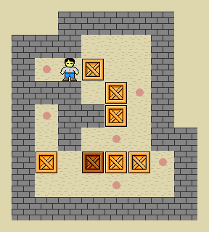
Puzzle Games
Important aspect – Ingenious and Thinking power
Examples
Many maze games are based on puzzle solving, reaction time is less important
Board games
Sliding puzzles (e.g. Fifteen puzzle, Sokoban)
Easy to create (usually 2D)
NEED AI when play against a computer opponent

Slide 39
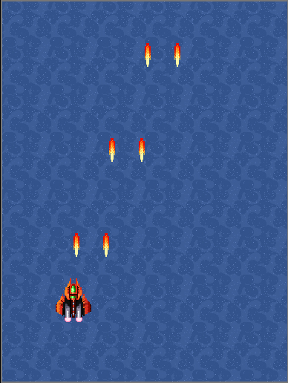
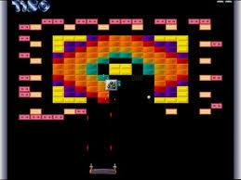
Arcade Games
Key aspect:
Reaction and speed
Examples:
maze games like Pacman
paddle games like Breakout
Scrolling shooters (many)

Slide 40
Strategy Games
Real-time (RTS) or turn-based
Examples
Tactics less important than Strategy
Player only indirectly controls the character
Resource gathering is commonly the main focus
Example: StarCraft II – Heart of the Swarm, Age of Empires, Warcraft III
Generally take a lot of time to create
require many different game objects, each with animated images and specific behavior

Slide 41
Role Playing Games
Players assume the roles of characters in a fictional setting
Examples
Diablo and Baldur's Gate
Players take responsibility for acting out these roles within a narrative
either through literal acting or
through a process of structured decision-making or
character development

Slide 42
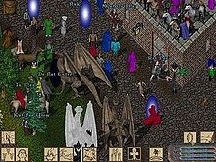
Role Playing Games (cont.)
The first commercially available RPG
Dungeons & Dragons (D&D)
Multiplayer
Ultima online

Slide 43

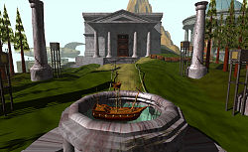
Adventure Games
In which the player assumes the role of protagonist in an interactive story driven by exploration and puzzle-solving instead of physical (e.g. reflexes) challenge
Key aspect - exploration
Story line is often crucial
Actions easy (just move)
Examples – Myst, The Walking Dead

Slide 44
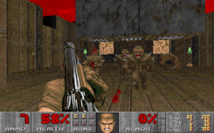
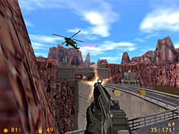
First-Person Shooters
The player experiences the action through the eyes of the protagonist
Centered on gun and projectile
weapon-based combat through a first-person perspective
Emphasis
fast-paced action and reaction speed
Not based on cleverness and puzzle solving
Examples: Doom, Half Life

Slide 45
Third-Person Action/Platformer
Player directly controls a game character through a hostile world
Tomb Raider, Prince of Persia
Fast action and discovering the game world
May have story line, other adventure game aspects

Slide 46

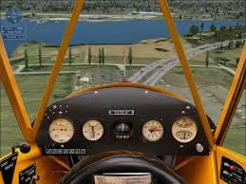
Simulators
Realistic representation
Example: Flight simulators, SimCity

Slide 47
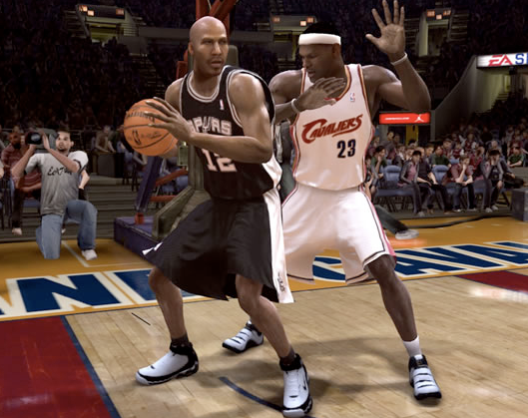
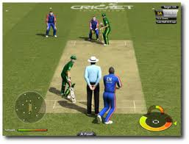
Sports Games
Simulates the practice of traditional sports
Sports games involve
physical and tactical challenges
test the player's precision and accuracy
Examples - NBA Live, FIFA series, Cricket

Slide 48
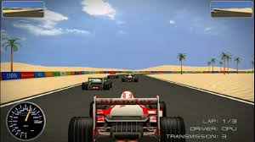
Racing Games
Either in the first-person or third-person perspective, in which the player partakes in a racing competition with any type of land, air, or sea vehicles
Example - Formula 1

Slide 49
Educational Games
Educational games are designed to teach
math, reading, problem solving

Slide 50
Reference
Some information and images are taken from the different online sources, only for educational purpose. I acknowledge them.
http://en.wikipedia.org/wiki/History_of_video_games
http://users.tkk.fi/~eye/videogames/index.html
http://www.thedoteaters.com/
http://www.pong-story.com/intro.htm
Some are based on notes from Mark Overmars

Slide 51
Thank you!

